Slide 1

Classification of Numbers DIVISIBILITY Rules & BODMAS

Slide 2
Classification of Numbers
Detail classification of numbers
Problem on types of Number(Integers, Natural, Even-Odd)
Problem based on Prime Numbers
Word Problem on Numbers
Decimal to fraction Conversion
DIVISIBILITY Rules
Division algorithm
Divisibility Rules
Concept of factors of 1001 & Practice from PPT
Problem on divisibility
Data Sufficiency on related topic

Slide 3
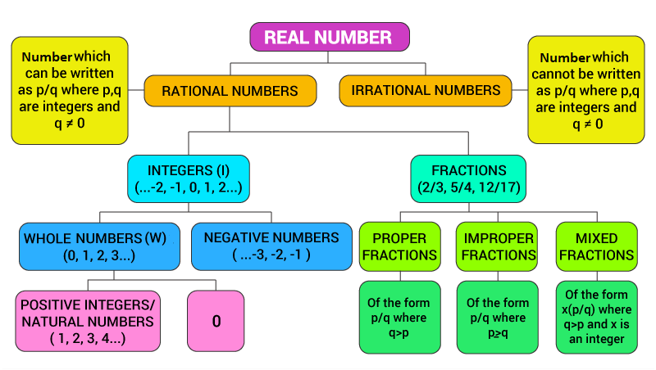
Classification of Numbers

Slide 4
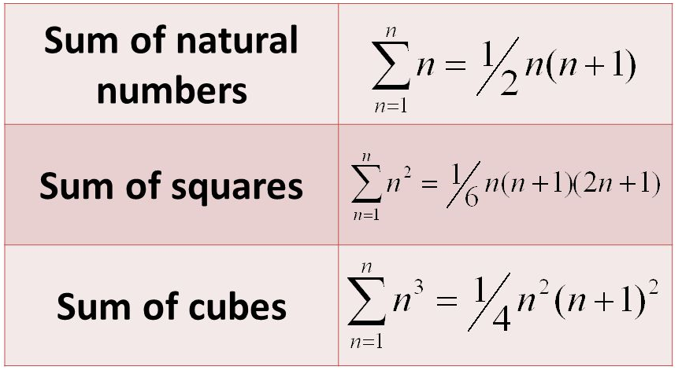
Classification of Numbers
Important Formulas:

Slide 5
Classification of Numbers
Q1. The sum of first 12 natural numbers is:
78 B) 98 C) 68 D) 88
Notes:
Difficulty level: Easy (Compulsory)
Answer - A

Slide 6
Classification of Numbers
Q2. For how many integer values of P will the value of the expression 4P+ 7 be an integer greater than 1 and less than 230?
A) 50 B) 58 C) 57 D) 56
Notes:
Answer - C

Slide 7
Classification of Numbers
Q3. a is positive even integer and b is positive odd integer then which of the following is odd?
A) a*b B) (a+b)a C) a²b/2 D) a+b
Notes:
Difficulty level: Easy (Compulsory)
Answer -D

Slide 8
Classification of Numbers
Q4. The sum of three consecutive odd numbers is 579. What is the middle number?
A) 189 B) 193 C) 169 D) 213
Notes:
Answer - B

Slide 9
Classification of Numbers
Q5. If N²-33, N²-31 and N²-29 are prime numbers, then what is the number of possible values of N, where N is an integer?
a) 1 b) 2 c)3 d) None of these
Notes:
Difficulty level: Moderate (Compulsory)
Answer - B

Slide 10
Classification of Numbers
Q6. a , b, c and d are prime numbers such that a<b<c<d<16. In how, many cases (a+b+c) also be a prime number?
a)1 b) 2 c) 3 d) 4
Notes:
Answer- B

Slide 11
Classification of Numbers
Q7. The product of a number and thrice of its multiplicative inverse is:
A) 3 B) 0 C) -1 D) Infinity
Notes:
Difficulty Level: Easy (Compulsory)
Answer -A

Slide 12
Classification of Numbers
Q8. The difference of two numbers is 14 and (1/5)th of their sum is 8. The larger number is:
A) 27 B)13 C)18 D)19
Notes:
Difficulty Level: Moderate (Compulsory)
Answer - A

Slide 13
Classification of Numbers
Q9. There are two numbers such that the sum of twice the first number and thrice the second number is 120 and sum of thrice the first number and twice the second number is 100. Which is the smaller number ?
A) 32 B) 24 C) 12 D) 38
Notes:
Answer - C

Slide 14
Classification of Numbers
Q10. what is the simplified fraction value of
0.045
45/99 B) 9/11 C) 5/11 D) None of these
(ii) 0.012
A) 121/99 B) 11/900 C)121/990 D) 11/90
Notes:
Difficulty Level: Moderate (Compulsory)
11. (i) Answer-D
11. (ii) Answer- B

Slide 15
Division Algorithms
1) If a and b are integers ; b>0
then there exist unique integer q and r satisfying
a=qb+r; 0≤ r ≤ b
where q and r are called quotient and remainders in the division of a by b.
2) If a and b are integers ; b<0
then there exist unique integer q and r satisfying
a=qb+r; 0≤ r ≤ |b|
where q and r are called quotient and remainders in the division of a by b.

Slide 16
Divisibility rules of 2,4,8
2 – Last digit is even (0,2,4,6,8)
4- Last two digits are divisible by 4 (124, 123456, 23468) 8- Last three digits are divisible by 8 (123488, 1234888)

Slide 17
Divisibility rules of 3, 9
3 – Sum of the digits is divisibly by 3
9 – Sum of the digits is divisible by 9
Divisibility rule of 6:
If a number is divisible by 2 and 3,it is divisible by 6
Divisibility rules of 6

Slide 18
Divisibility rules of 6
Ex: 246
a.2+4+6= 12, 12 is divisible by 3,so 246 is divisible by 3 b.246 ends in 6,so 246 is divisible by 2
246 is divisible by 2 and 3 .so 246 is divisible by 6

Slide 19
Divisibility rules of 7
Take the last digit and double it, subtract that from the remaining digits, continue until you get a number that is divisible by 7.
Example: 442 Take the last digit and double it, 2*2 = 4 44 – 4 = 40 Is 40 a multiple of 7?No, hence , 442 is not divisible by 7

Slide 20
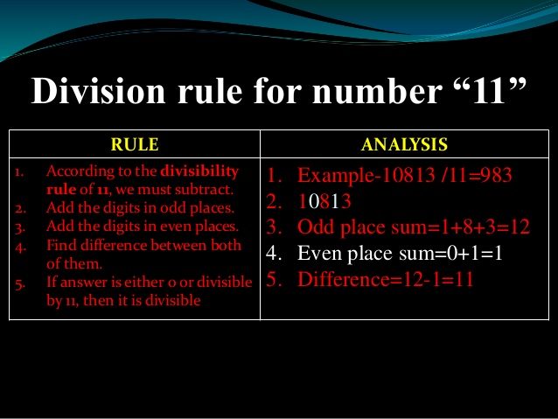
Divisibility rules of 11

Slide 21
Divisibility rules of Prime Numbers: 13
Take the last digit and multiply by 4 , Add the product to the rest of the number
Example: 442 Take the last digit and double it, 2*4 =8 44 + 8 = 52
Is 52 a multiple of 13? Yes, hence ,442 is divisible by 13.

Slide 22
Divisibility rules of Prime Numbers: 17
Take the last digit and multiply by 5 , Subtract the product to the rest of the number
Example: 15181 Take the last digit and multiply it by 5, 1*5 =5 1518- 5 = 1513
Take the last digit again and multiply it by 5, 3*5 =15
151-15=136
Is 136 a multiple of 17? Yes, hence ,15181 is divisible by 17.

Slide 23
Triplet Method for Divisibility rules of Prime Numbers
Make the triplets from the given numbers from right end subtract first triplet with 2nd, 3rd with 4th and so on then if the sum of resultant is divisible by 7 then number is also divisible by 7. Mostly this method is advisable to apply on number with some specific symmetrical pattern
Example:8955795758 ,Divisible by 7 Explanation: We express the number in terms of triplets of digits as follows. (008)(955)(795)(758) Now, 758- 795 + 955 - 8 = 910, which is divisible by 7
8955795758 ,Divisible by 13 Explanation: We express the number in terms of triplets of digits as follows. (008)(955)(795)(758) Now, 758- 795 + 955 - 8 = 910, which is divisible by 13

Slide 24
Divisibility Rule :Practice Questions
Q11. On dividing 4356 by a certain number , the quotient is 55 and the remainder is 11, the divisor is
A) 79 B) 78 C) 76 D) 75
Notes:
Answer - A

Slide 25
Divisibility Rule :Practice Questions
Q12. N is a whole number which when divided by 8 gives 5 as remainder. What will be the remainder when 2×N is divided by 4?
A) 3 B) 2 C) 1 D) 0
Notes:
Difficulty Level: Moderate (Compulsory)
Answer-B

Slide 26
Divisibility Rules: Practice Questions
Q13. Find the least value of * for which 5822*18 is divisible by 11?
A] 5 B] 3 C] 7 D] 11
Notes:
Difficulty level: Easy (Compulsory)
Answer - C

Slide 27
Divisibility Rule :Practice Questions
Q14. Which of the number is divisible by 3,7 and 9 all three?
A. 4371 B. 4359 C. 5673 D. 4473
Notes:
Difficulty Level: Easy
Answer-D

Slide 28
Divisibility Rule :Practice Questions
Q15. If Y is natural number , then (8Y²+8Y) is always divisible by:
A) 6 only B) 6 and 12 both
C) 12 only D) by 16 only
Notes:
Answer- D

Slide 29
Divisibility Rule :Practice Questions
Q16. If 9A4146B is divisible by 88, then what is the value of A x B?
A) 10 B) 15 C) 12 D) 16
Notes:
Difficulty level: Moderate(Compulsory)
Answer - C

Slide 30
Divisibility Rule :Practice Questions
Q17. There is a 24 digit number consist of only one digit from 1,2,3,4,5 or 6, e.g. 22222222…………22, 555555……55. Such number is always divisible by:-
A) 7 B) 11
C) 13 D) All of the above
Notes:
Answer - D

Slide 31
Divisibility Rule :Practice Questions
Q18. A six-digit number is formed by repeating a three-digit number; for example, 808808 or 416416 etc. Any number of this form is always exactly divisible by:
A) 7 B) 11 C) 13 D) 1001 E) All of these
Notes:
Difficulty level: Moderate (Compulsory)
Answer - E

Slide 32
Divisibility Rule :Practice Questions
Q19. A number 41678 is divisible by:
7 only B) 11only
C) 13 only D) 7 and 13 both
E) All of these
Notes:
Difficulty level: hard(compulsory)
Answer - D

Slide 33
Divisibility Rule: Practice Questions
Q20. Which of the following number is divisible by 17?
19654 B) 14324 C) 14357 D) 14399
Notes:
Difficulty level: Moderate(compulsory)
Answer - D

Slide 34
Numbers , Divisibility Rules
Directions: In each of the questions below consists of a question and two statements numbered I and II given below it. You have to decide whether the data provided in the statements are sufficient to answer the question. Read both the statements and
Give answer
(A) If the data in statement I alone are sufficient to answer the question, while the data in statement II alone are not sufficient to answer the question
(B) If the data in statement II alone are sufficient to answer the question, while the data in statement I alone are not sufficient to answer the question
(C) If the data either in statement I alone or in statement II alone are sufficient to answer the question
(D) If the data given in both statements I and II together are not sufficient to answer the question and
(E) If the data in both statements I and II together are necessary to answer the question

Slide 35
Data Sufficiency: Classification of Numbers
Q24. Is x an even number?
Statement I: 6x + 5y is an even number.
Statement II: 3x + 6y is an even number.
Notes:
Difficulty level: Easy(Compulsory)
Option: B

Slide 36


